Slide 1
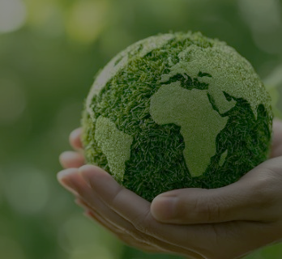
NIGERIA STATES AIR QUALITY RISK SCORES
AN INTERACTIVE MAP CREATED BY RACHAEL OLUWAKEMI AGUNLOKO
USING QGIS, GOOGLE EARTH ENGINE, SENTINEL SATELLITE AND PYTHON
LIVE INTERACTIVE MAP: https://rachaelkemi01-dataanalyst.github.io/Nigeria-States-Air-Quality-Risk-Scores-Portfolio-Environmental-Risk-Index-/qgis2web_2026_08_10-14_51_24_885805/#6/9.525/4.790

Slide 2
PRESENTATION OUTLINE
Overview
Methodology and Tools
Map Usage Guide
Summary of Analysis
Recommendation
2

Slide 3
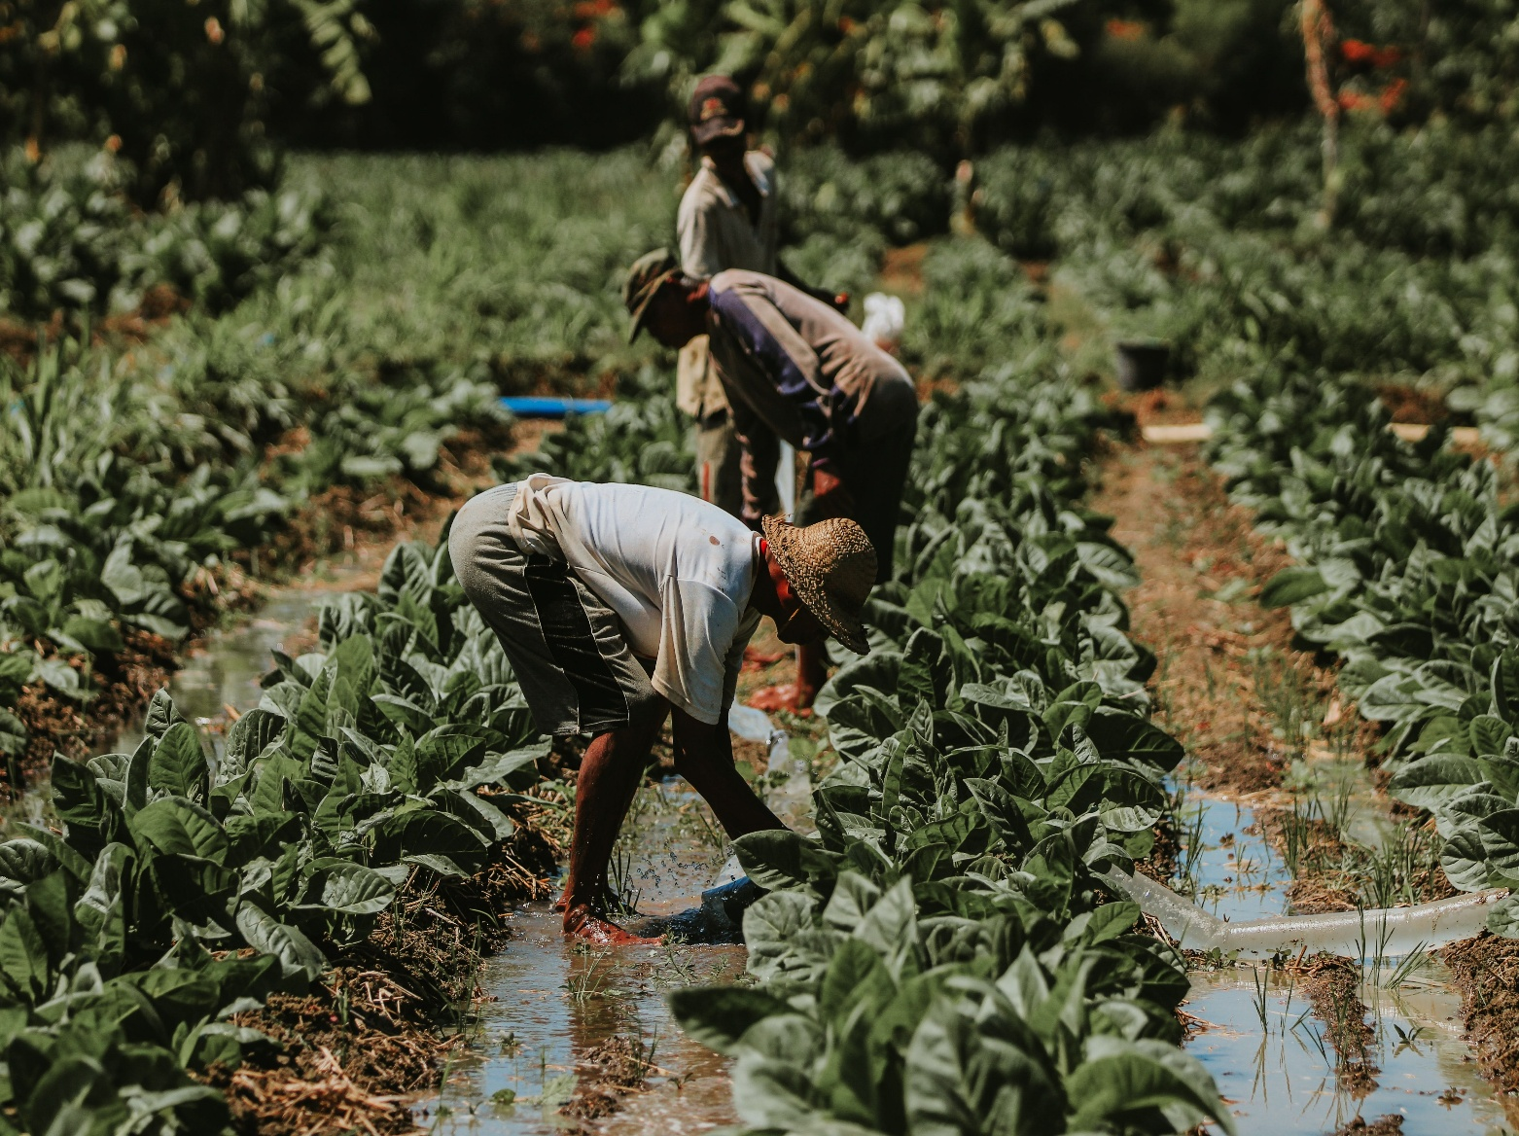
Overview
Human activities are major factors influencing climate change and disrupts the Ecosystem.
The living environment is surrounded by air and most living things depend on air for survival.
This project aims to utilize remote sensing, Geographic Information system and data analytical tools to evaluate air quality risk score of different states in Nigeria
Figure 1: Farmers on a field (Setengah, 2024)
3

Slide 4
Methodology
Data source: Google Earth Engine and Sentinel Satellite.
Data Processing and Analysis : Python, QGIS and PyQGIS.
Output: A labelled choropleth map of air quality risk scores across the study area, published as an interactive web map (via qgis2web) and GitHub : https://rachaelkemi01-dataanalyst.github.io/Nigeria-States-Air-Quality-Risk-Scores-Portfolio-Environmental-Risk-Index-/qgis2web_2026_08_10-14_51_24_885805/#6/9.525/4.790
4

Slide 5
Map Usage Guide
Zoom the map to explore the risk scores of the states in Nigeria
Explore the map by choosing either state or risk category level
5

Slide 6
Summary of the Analysis
33 states have low air quality risk score
1 out of 36 states has moderate risk score
(Lagos)
Data is unavailable for Abuja and Nassarawa states
6

Slide 7
Recommendation
There is need to place stricter preventive and regulatory measures on air pollution on Lagos state to reduce the level of air pollution and to prevent escalation
Adequate monitoring of the environment should be conducted in Lagos state especially at Local Government Level.
Prevention and regulatory practices should also be implemented in low risk states to conserve the environment
8

Slide 8

23

